Slide 1

Prototype Pattern
Dmytro Razvaliaiev
Student ID: 63751
Vistula University

Slide 2
What Prototype Pattern is about?
The Prototype design pattern is good for when creating new objects requires more resources than you want to use or have available. You can save resources by just creating a copy of any existing object that is already in memory.

Slide 3
Definitions
The Prototype - the interface that describes the clone() method.
Concrete Class(es) – cloned class that gets the original prototype attributes and an overwritten version of the clone().

Slide 4
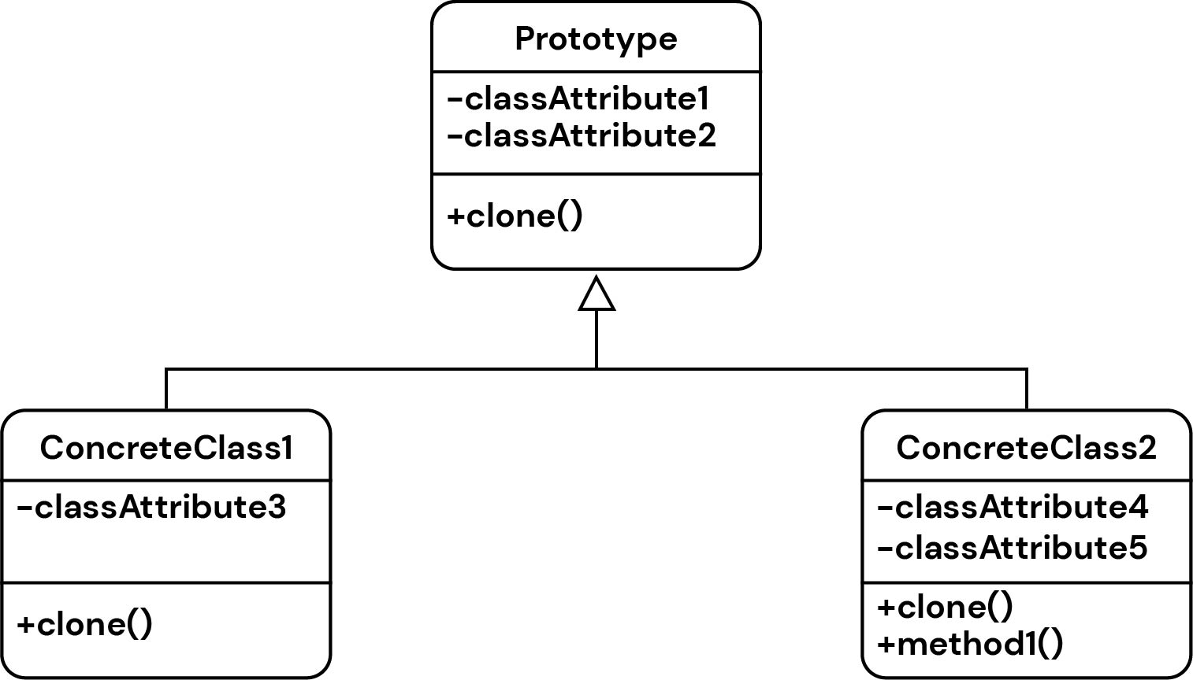
Prototype UML Diagram
Concrete Class(es) can also have their own attributes and methods

Slide 5
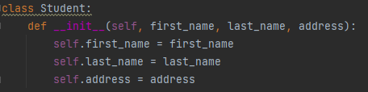
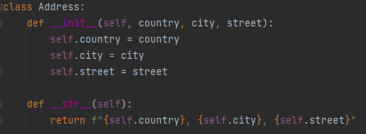
Why do we need it?
state_and_city
Let’s define a class called Student with the following attributes:
first_name;
last_name;
address.
Let’s define the magic method __str__ to print the student's data later.
Let’s define the class Address which will receive the data of student’s country, city and street with the magic method __str__

Slide 6
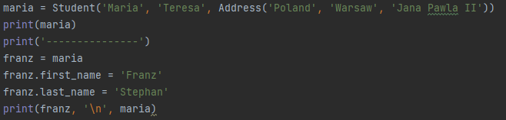

Why do we need it?
Next let’s create an object “maria”, define her full name and address, and print it:
Then we create another object “franz”, also input his full name and and let's assume that they live at the same address…maybe they are married ☺ :
Described assignment method is incorrect. Because variables are just links to the objects. So if we change the objects, the output values of “maria” and “franz” are changing too.

Slide 7

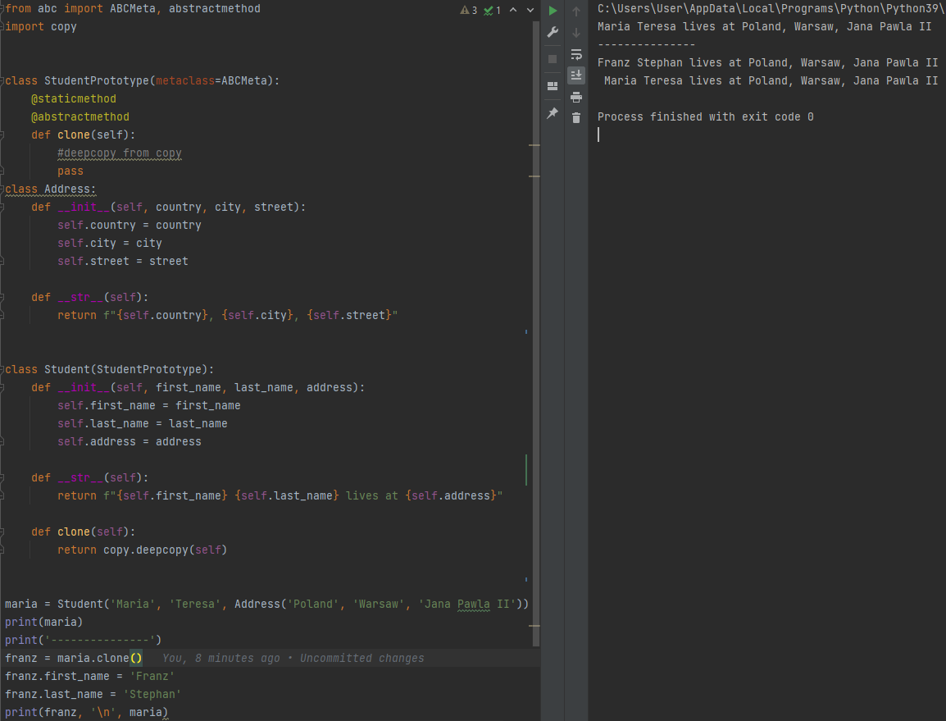

The solution is to make an abstract class with the abstract method “clone”.
Its python implementation consists of using “deepcopy” function of the “copy” library.
It makes a recursive copy of all object attributes.
Thus, it creates a completely new object in memory that does not refer to the original.
So now we can clone it as many times as we wish…

Slide 8
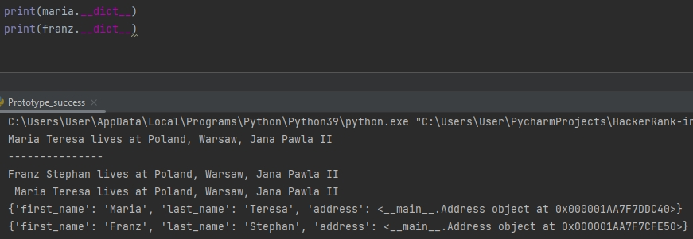


Let's do an additional check for the uniqueness of objects

